Slide 1
Analyzing Indian Clothing Retail Trends & Insights Q2-2022
Presented by
Team 7

Slide 2
Contents
Abstract
Data Collection Process & Source
Dataset Overview
Findings
Data Visualization and Dashboard
Conclusion
References

Slide 3
Abstract
In this presentation, we explore trends in an Indian clothing retail shop during Quarter 2 of 2022 Using Tableau visualizations, we examine maximum sales by top 15 cities, sales by category, order status by top 15 states, and sum and moving average of sales by day etc.
These insights provide a clear understanding of customer preferences, shopping behavior, and product demand in the clothing retail industry.
Our analysis helps retailers to make informed decisions about inventory management, pricing strategies, and marketing campaigns, and ultimately drive growth and profitability in the Indian clothing retail market.

Slide 4
Data Collection Process & Data Source
Dataset from https://www.kaggle.com/
Objective : Analyze sales overview for an online E commerce shop
Company Industry : Clothing Retail
Dataset Link : https://www.kaggle.com/datasets/thedevastator/unlock-profits-with-e-commerce-sales-data

Slide 5
Data Set Overview
Amazon E-Commerce dataset for an online clothing brand
Variables Measure Variable : Index, Qty, Amount Dimension Variable : Order ID, Date, Status, Fulfilment, Sales Channel, ship-service-level, Style, SKU, Category, Size, ASIN Courier Status currency ship-city, ship-state, ship-postal-code, ship-country, promotion-ids B2B fulfilled-by

Slide 6
Maximum total sales by top 15 cities
Task : Identifying cities with the highest sales.
Benefits : Focus marketing efforts
Allocate resources based on demand
Findings :
Bengaluru : ₹ 6.8 M
Hyderabad : ₹ 4.8 M
Mumbai : ₹ 3.7 M

Slide 7
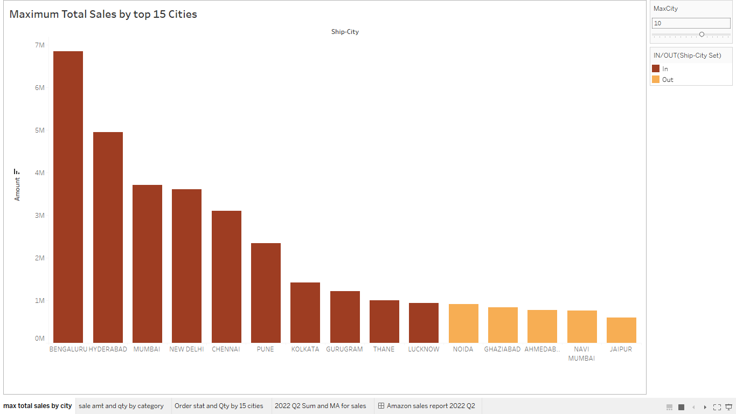

Slide 8
Sales Amount and Sales Quantity by Category
Task : Identifying the most profitable product categories.
Benefits: Determining which products to stock more and which to discontinue Findings:
Category | Quantity | Revenue (in ₹)
Set | 45.3 K | 39.20 M
Kurta | 45 K | 21.30 M
Western Dress | 13.9 K | 11.22 M

Slide 9
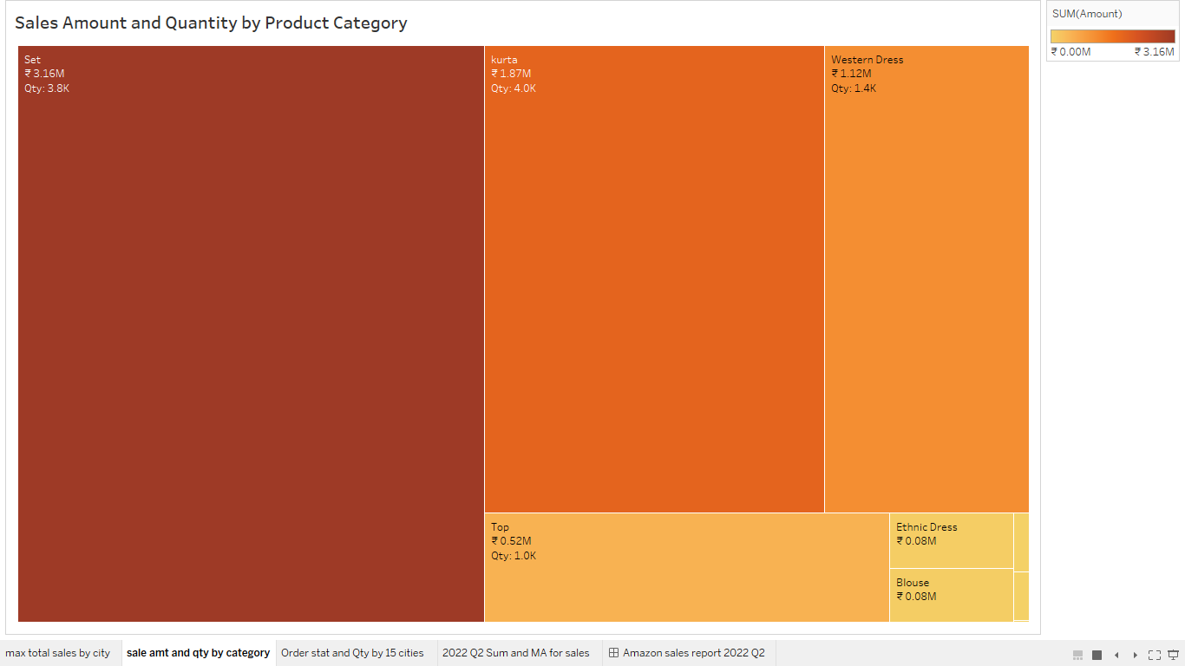

Slide 10
Order Status and Sales Quantity by Top 15 States
Task : Identifying states having most efficient order status
Benefits: Identify bottlenecks in the fulfillment process and improve efficiency. Address Issues and improve customer satisfaction
Findings:
State | Shipped | Unshipped | Total Orders | % Fulfilment
Maharashtra | 19154 | 1174 | 20328 | 94.2%
Karnataka | 15008 | 893 | 15901 | 94.3%
Tamil Nadu | 9860 | 552 | 10412 | 94.6%

Slide 11
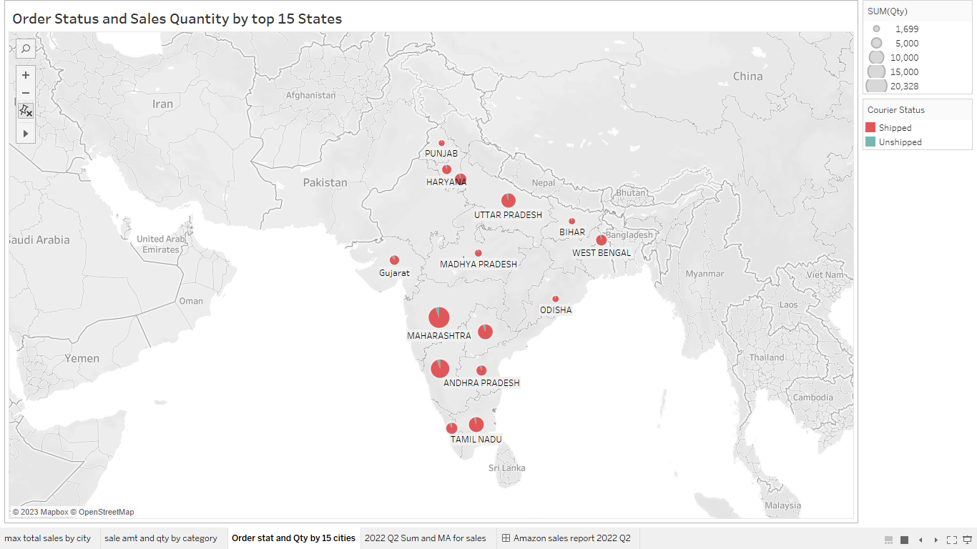

Slide 12
Sum and Moving Average of Sales amount by Day
Task : Identifying trends in sales over time
Benefits : Determine sales are rising/dropping over time.
Pricing and promotions can be detrmined.
Findings : There was a drastic increase in sales from April 1st week and it lasted till May 2nd week

Slide 13
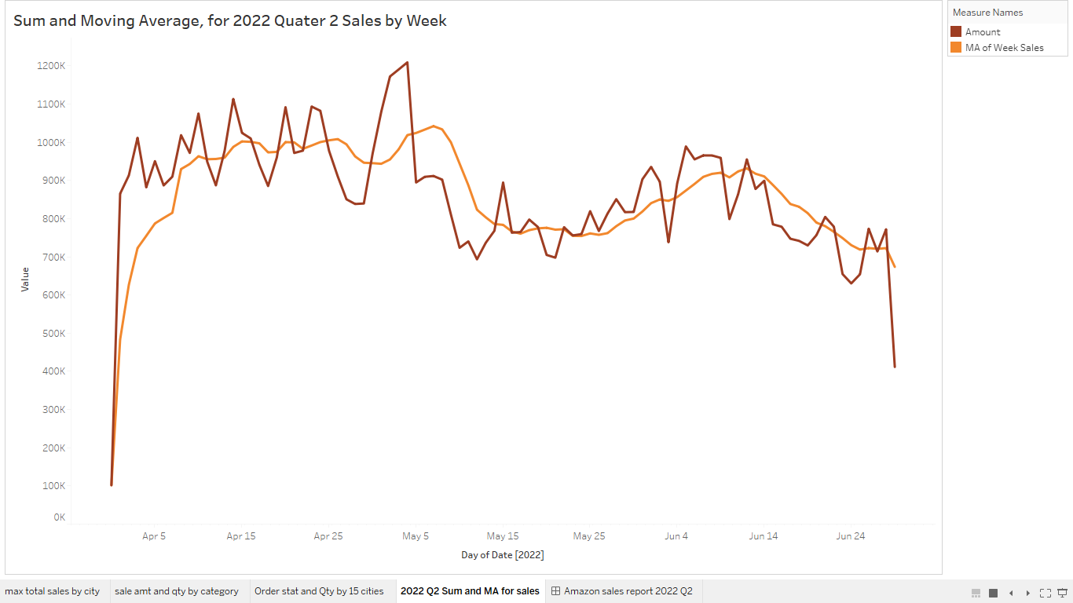

Slide 14
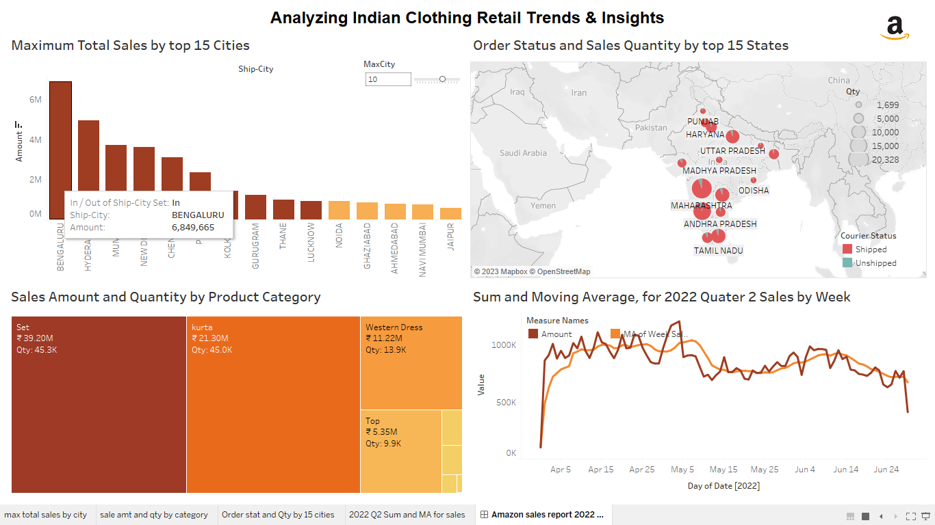
Dashboard

Slide 15
Findings and Conclusion
The best-selling products in each city, allowing for targeted product offerings. Bengaluru :
Set has Highest Sales 3.16 M (Qty 3.8 K) with 3535 shipped and 233 yet to ship.
Out of the total kurtas sales which is 45K generating 21.3 M rupees, 42% of the revenue came from top 15 cities by highest sales.

Slide 16
Findings and Conclusion Contd..
Based on Sales vs Quantity statistics, the warehouses in cities of Maharashtra state should focus on having more stock of Set to maximize Revenue.
Promotions or discounts should be given on products like Bottom and Ethnic wares throughout India for having sales.

Slide 17
Do you have any questions regarding the project?

Slide 18
THANK YOU

